Slide 1
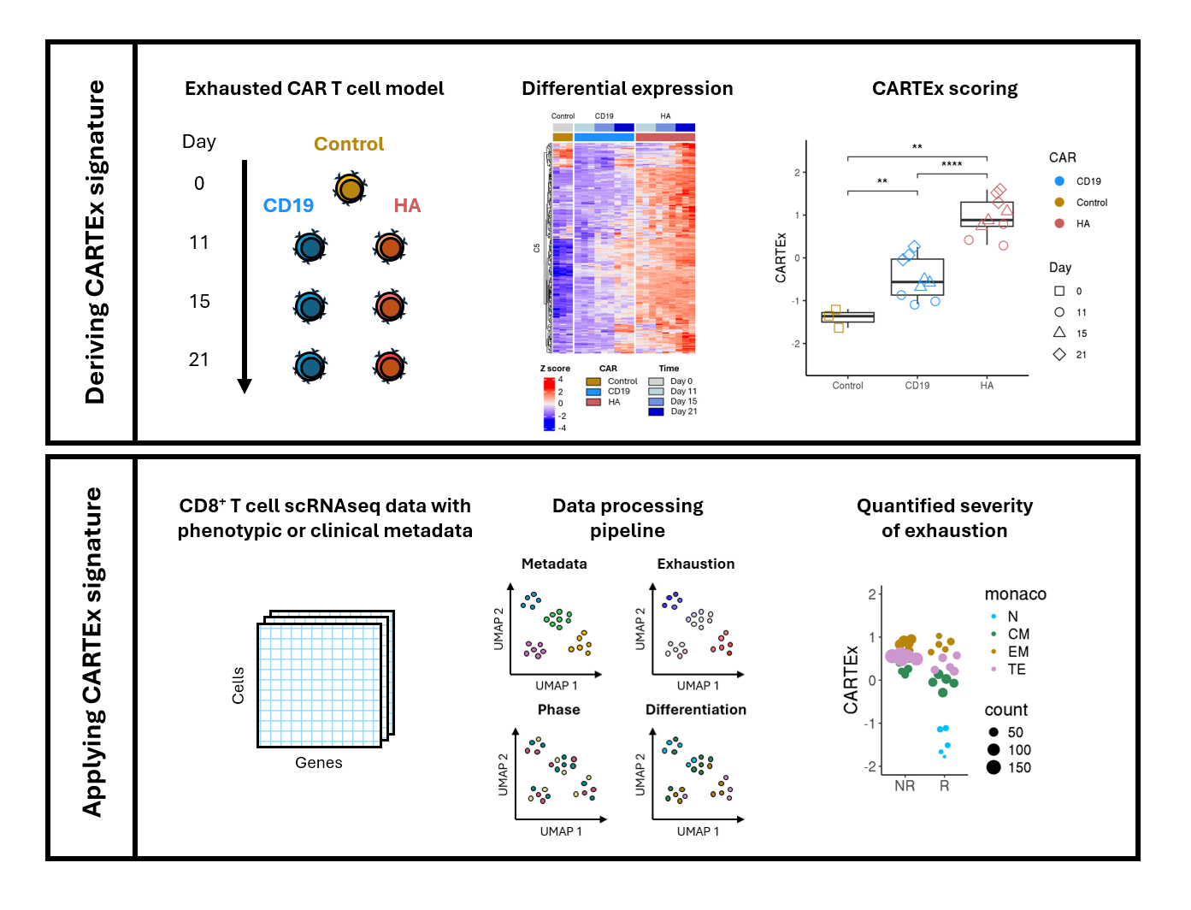
CARTEx project
Graphical abstract

Slide 2
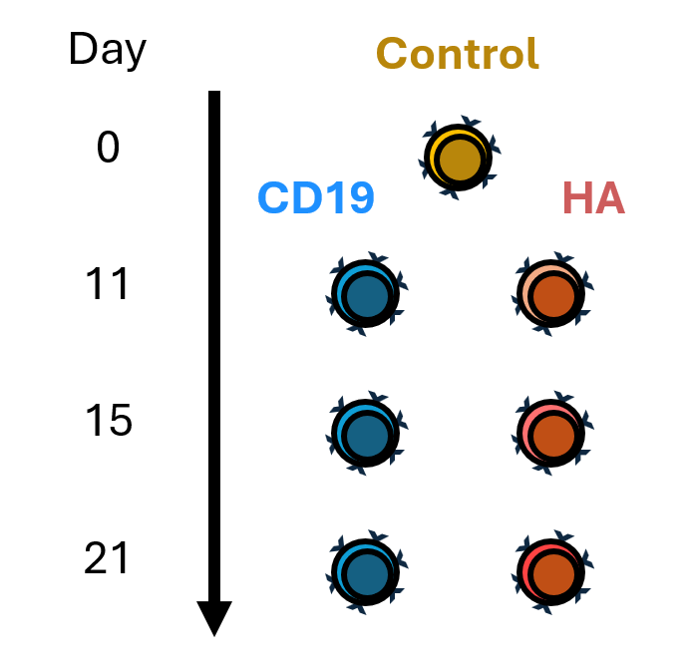
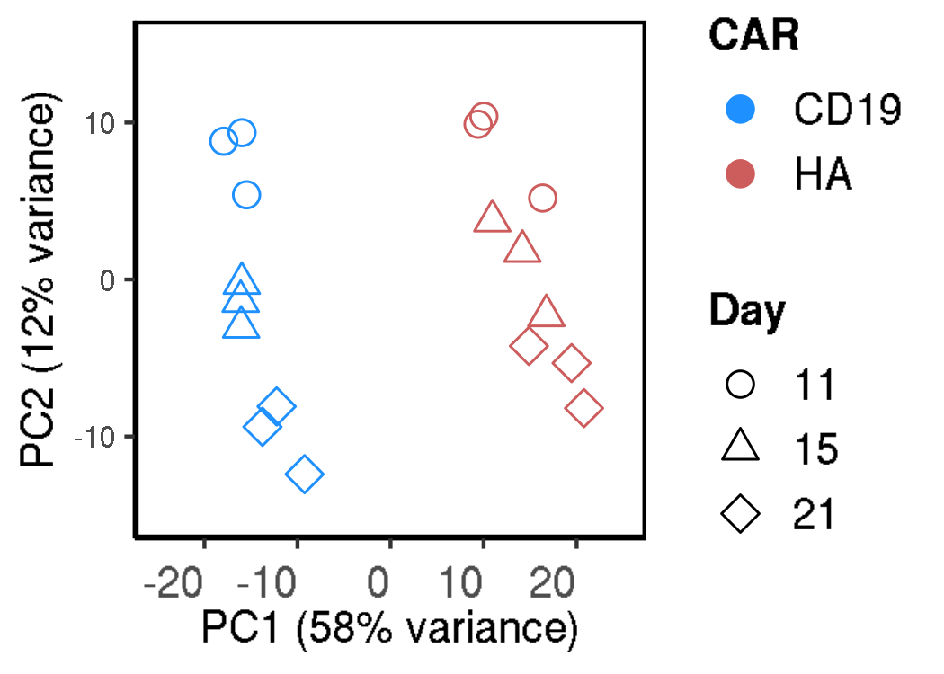
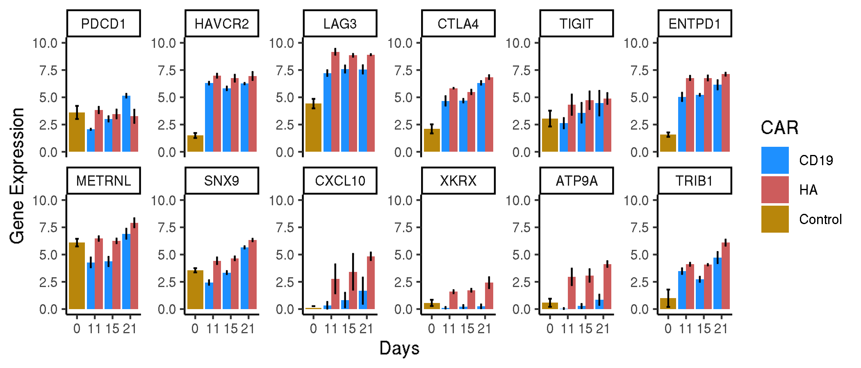
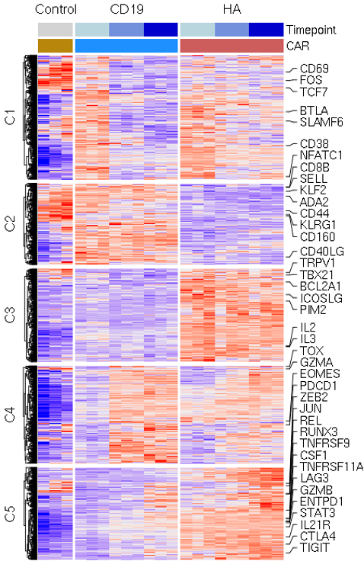
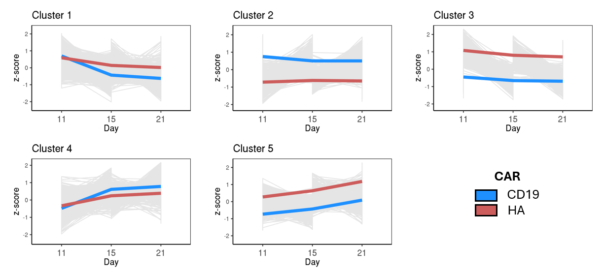
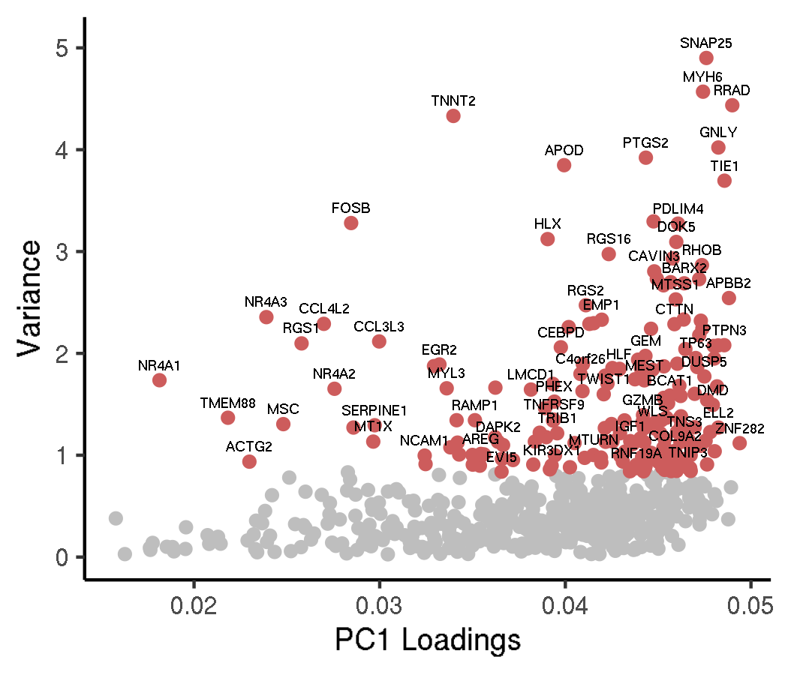
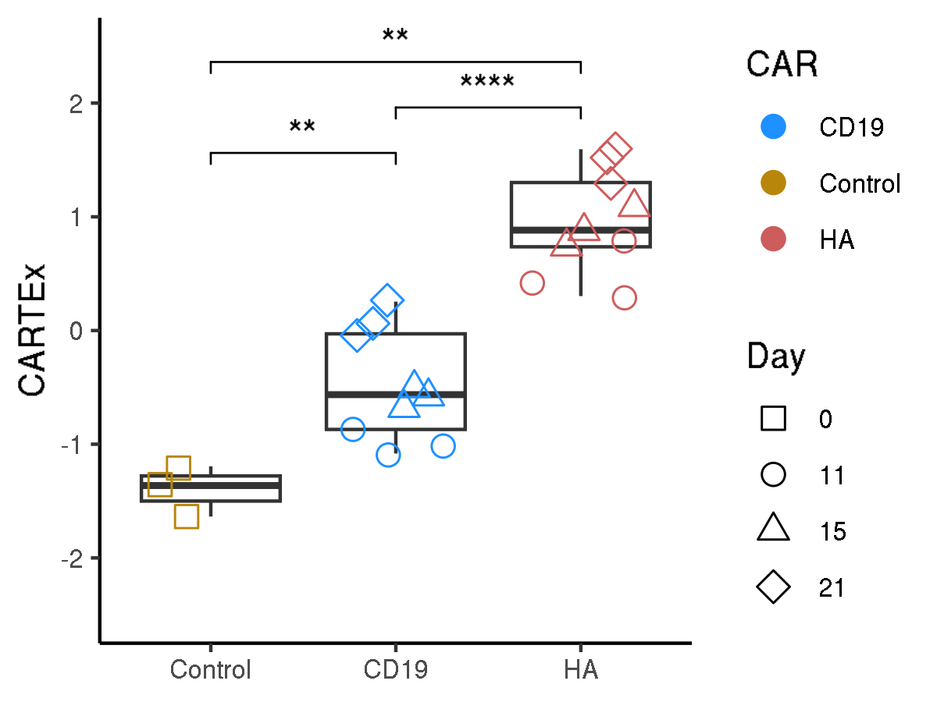
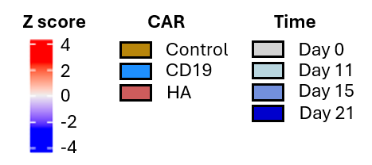
CARTEx project
Figure 1. Bulk RNA sequencing of sorted functional and exhausted CD8+ CAR T cells across 21 days
A
B
C
D
E
F
G

Slide 3
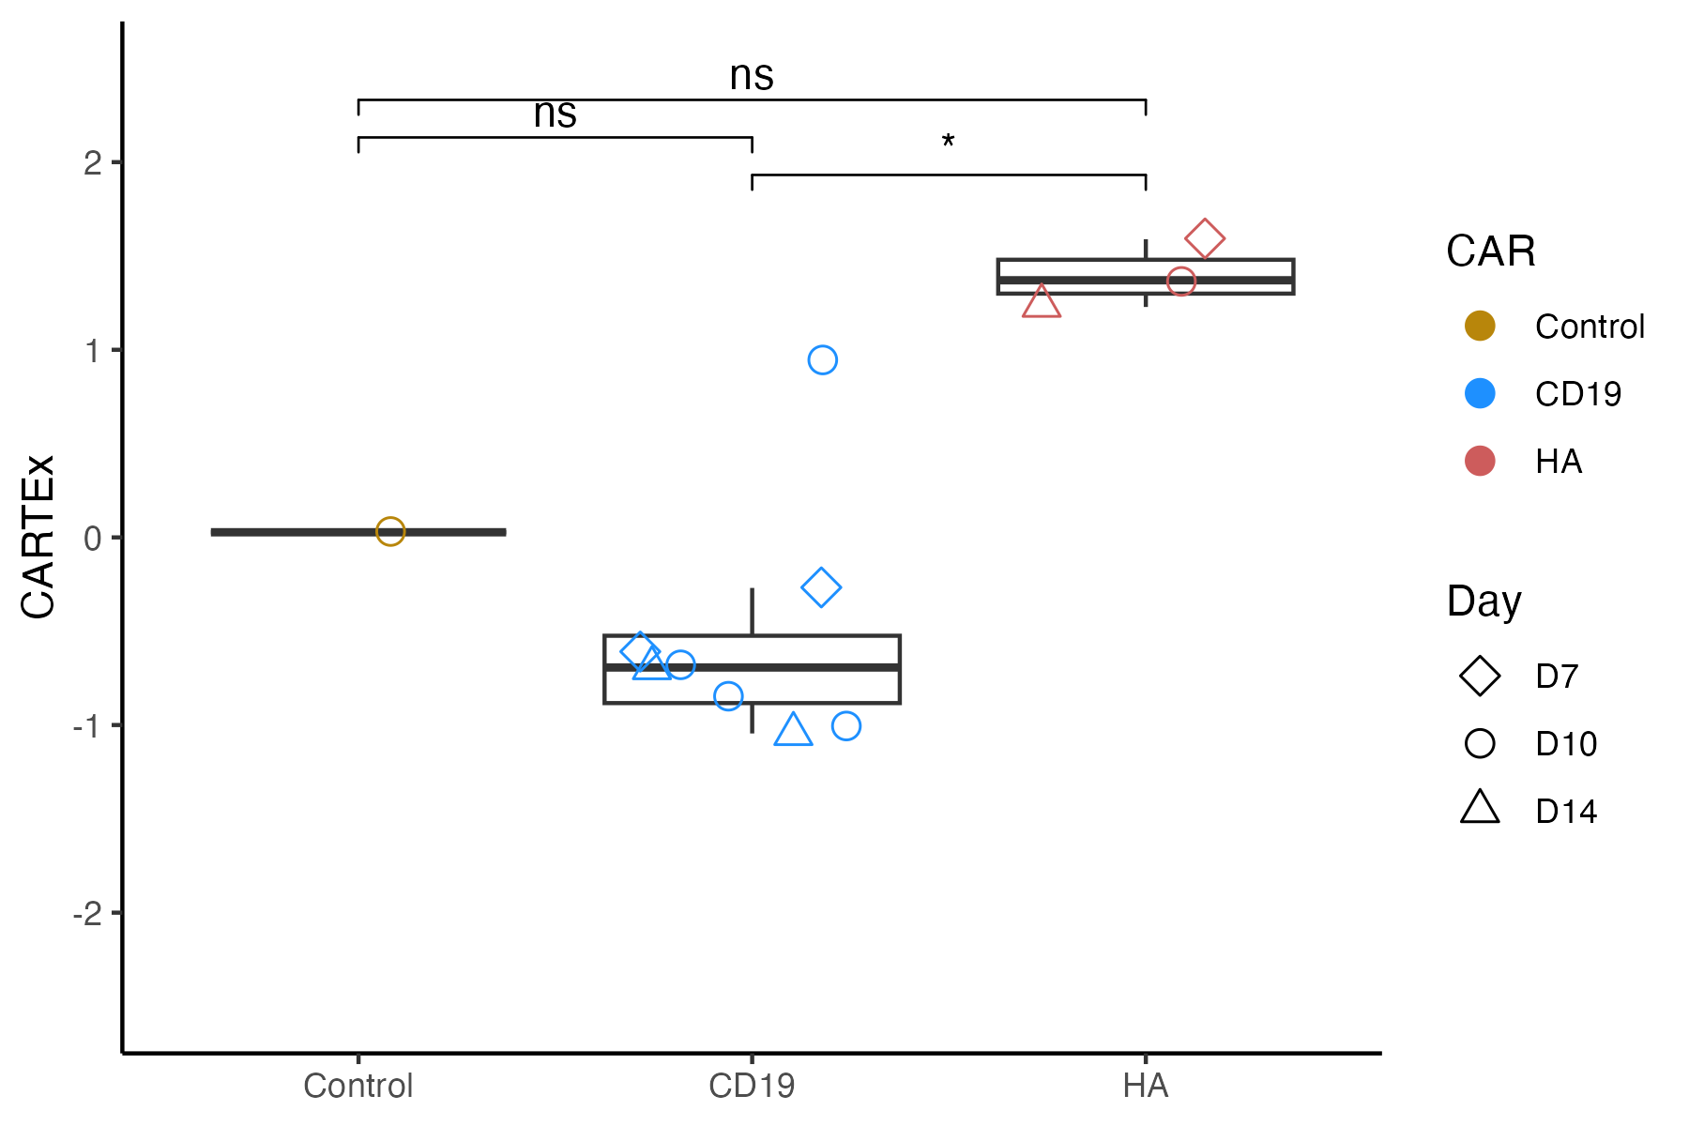
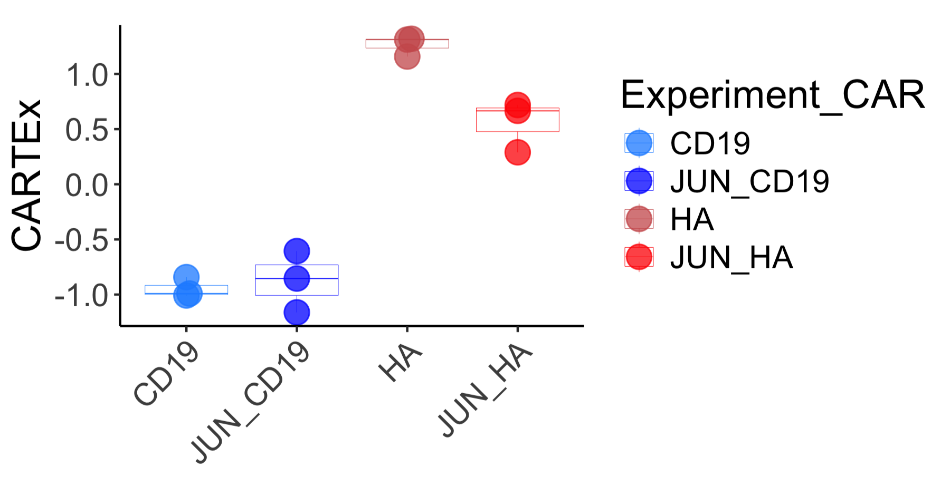
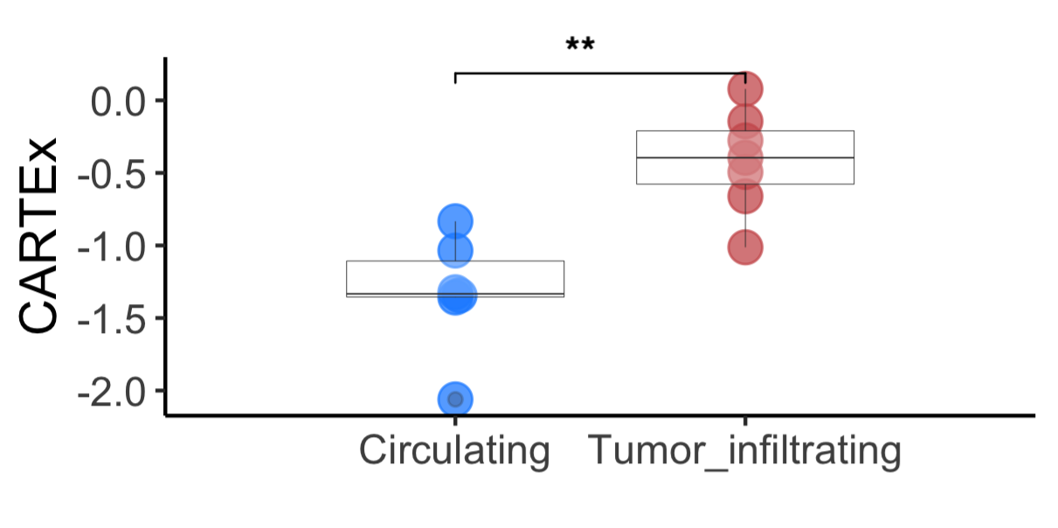
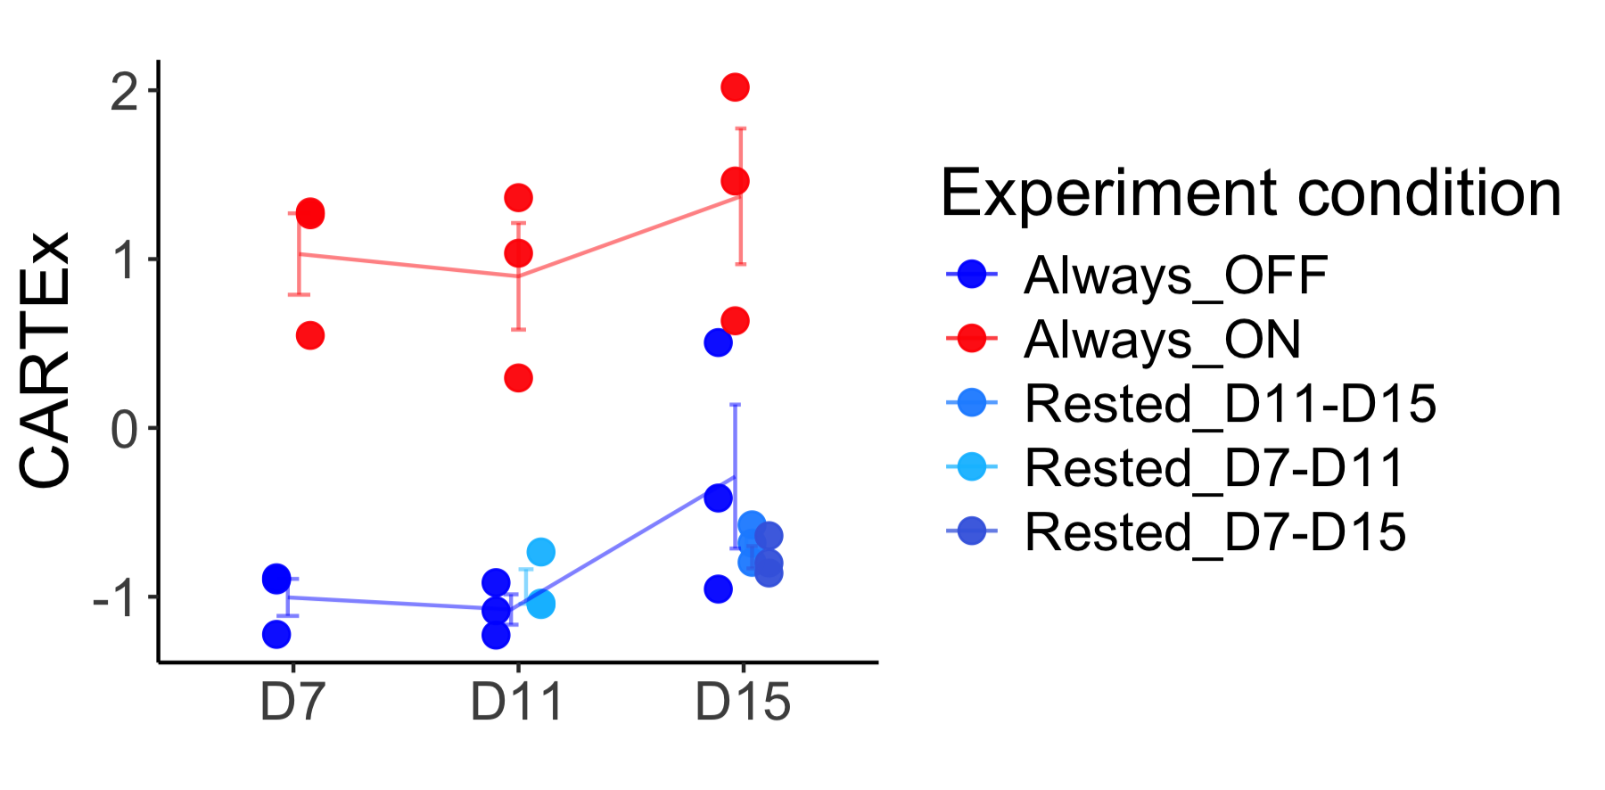
CARTEx project
Figure 2. Application of CARTEx signature in bulk RNAseq experiments
A
B
D
C

Slide 4
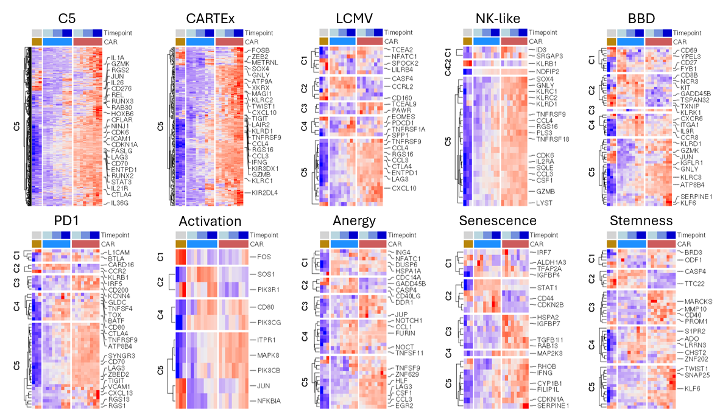
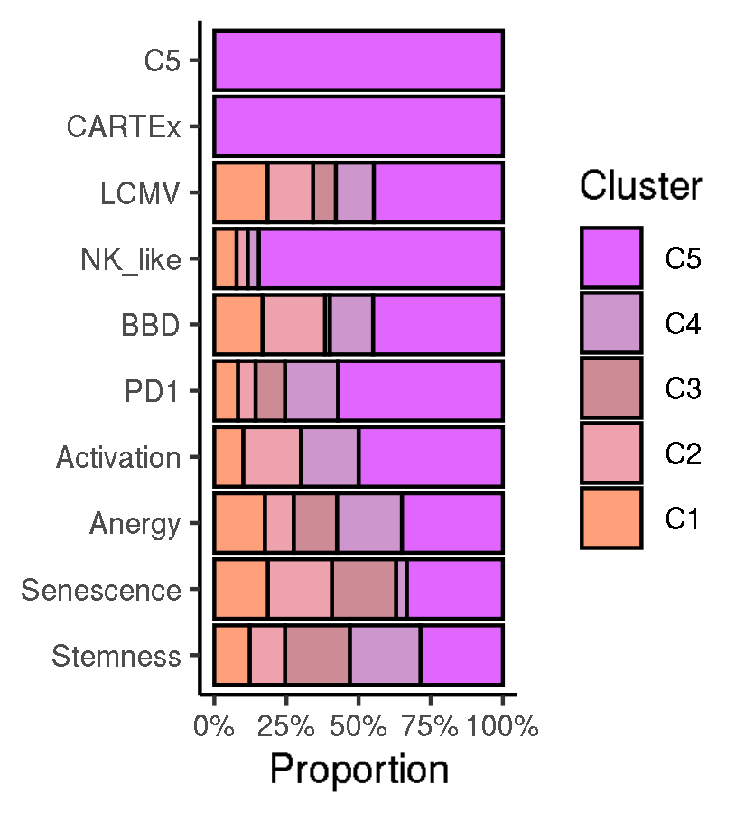
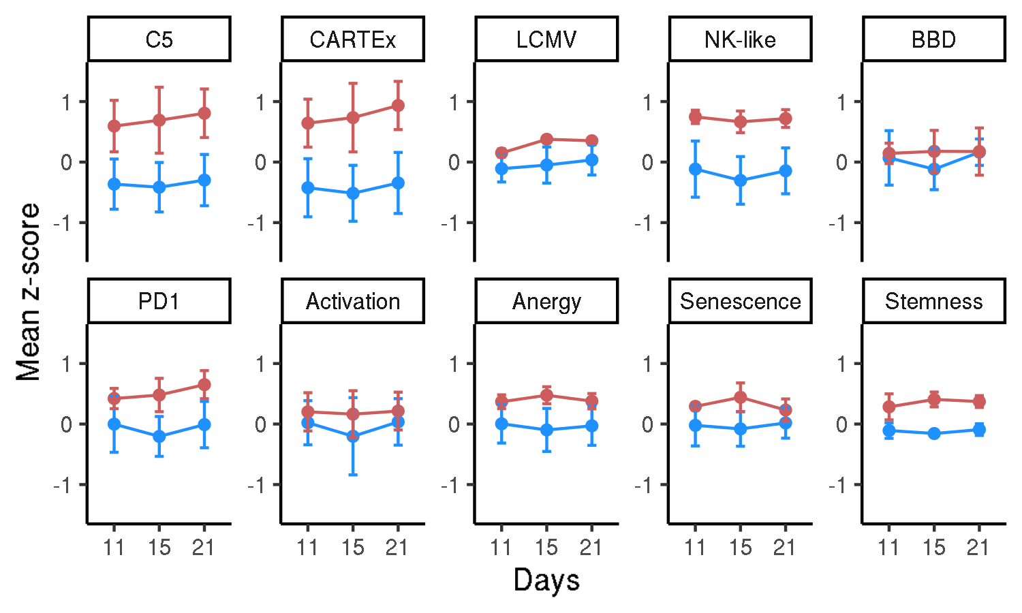
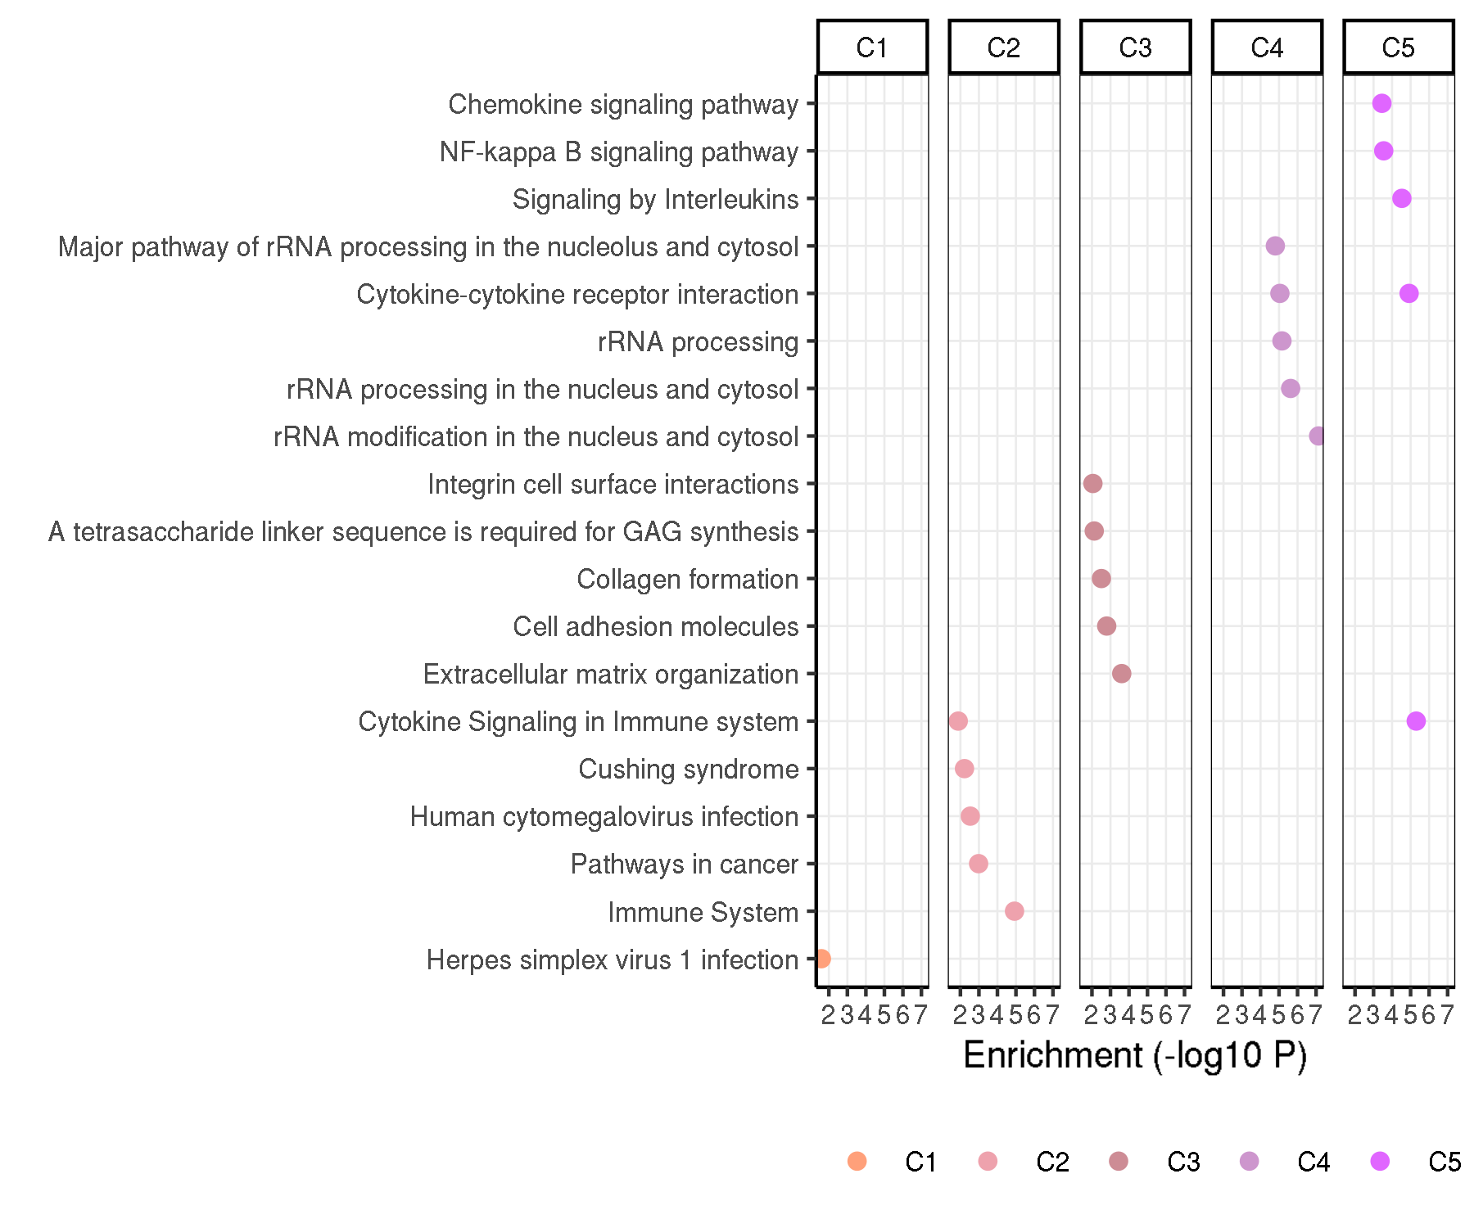
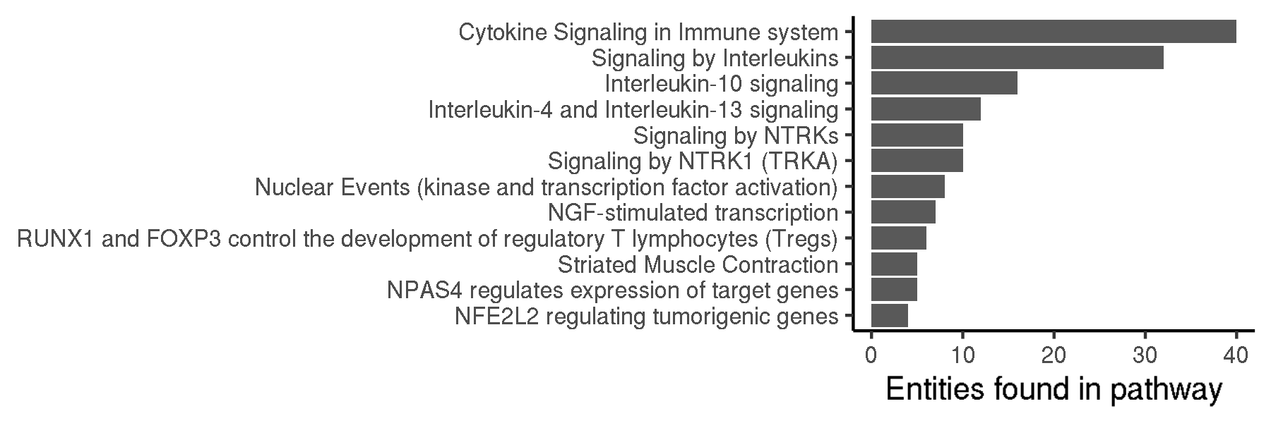
CARTEx project
Figure 3. Contextualizing the CARTEx signature
A
B
C
D
E

Slide 5
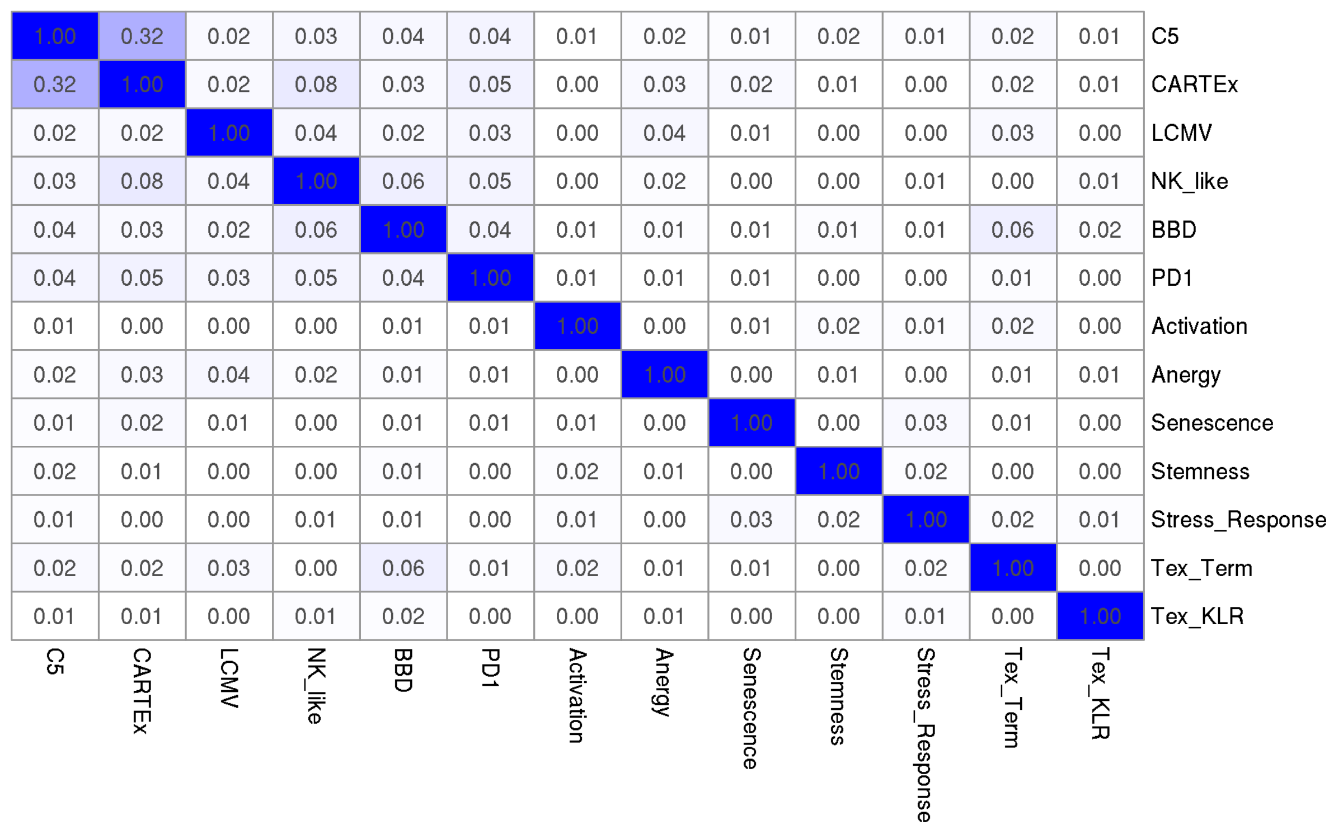
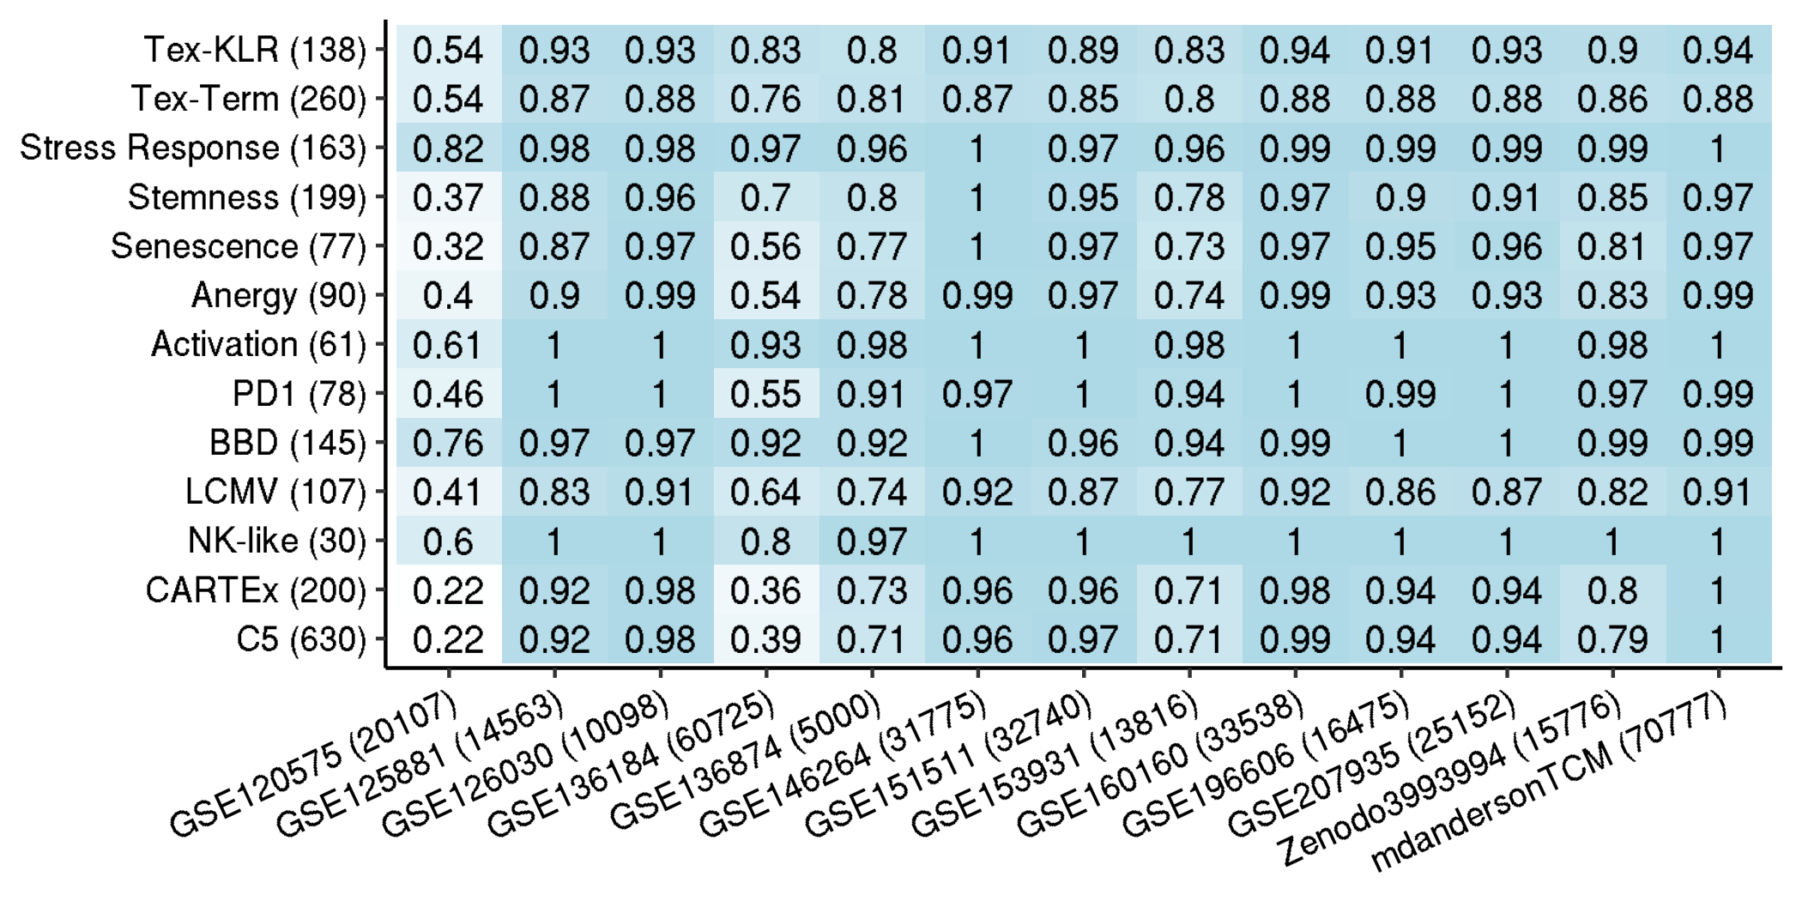
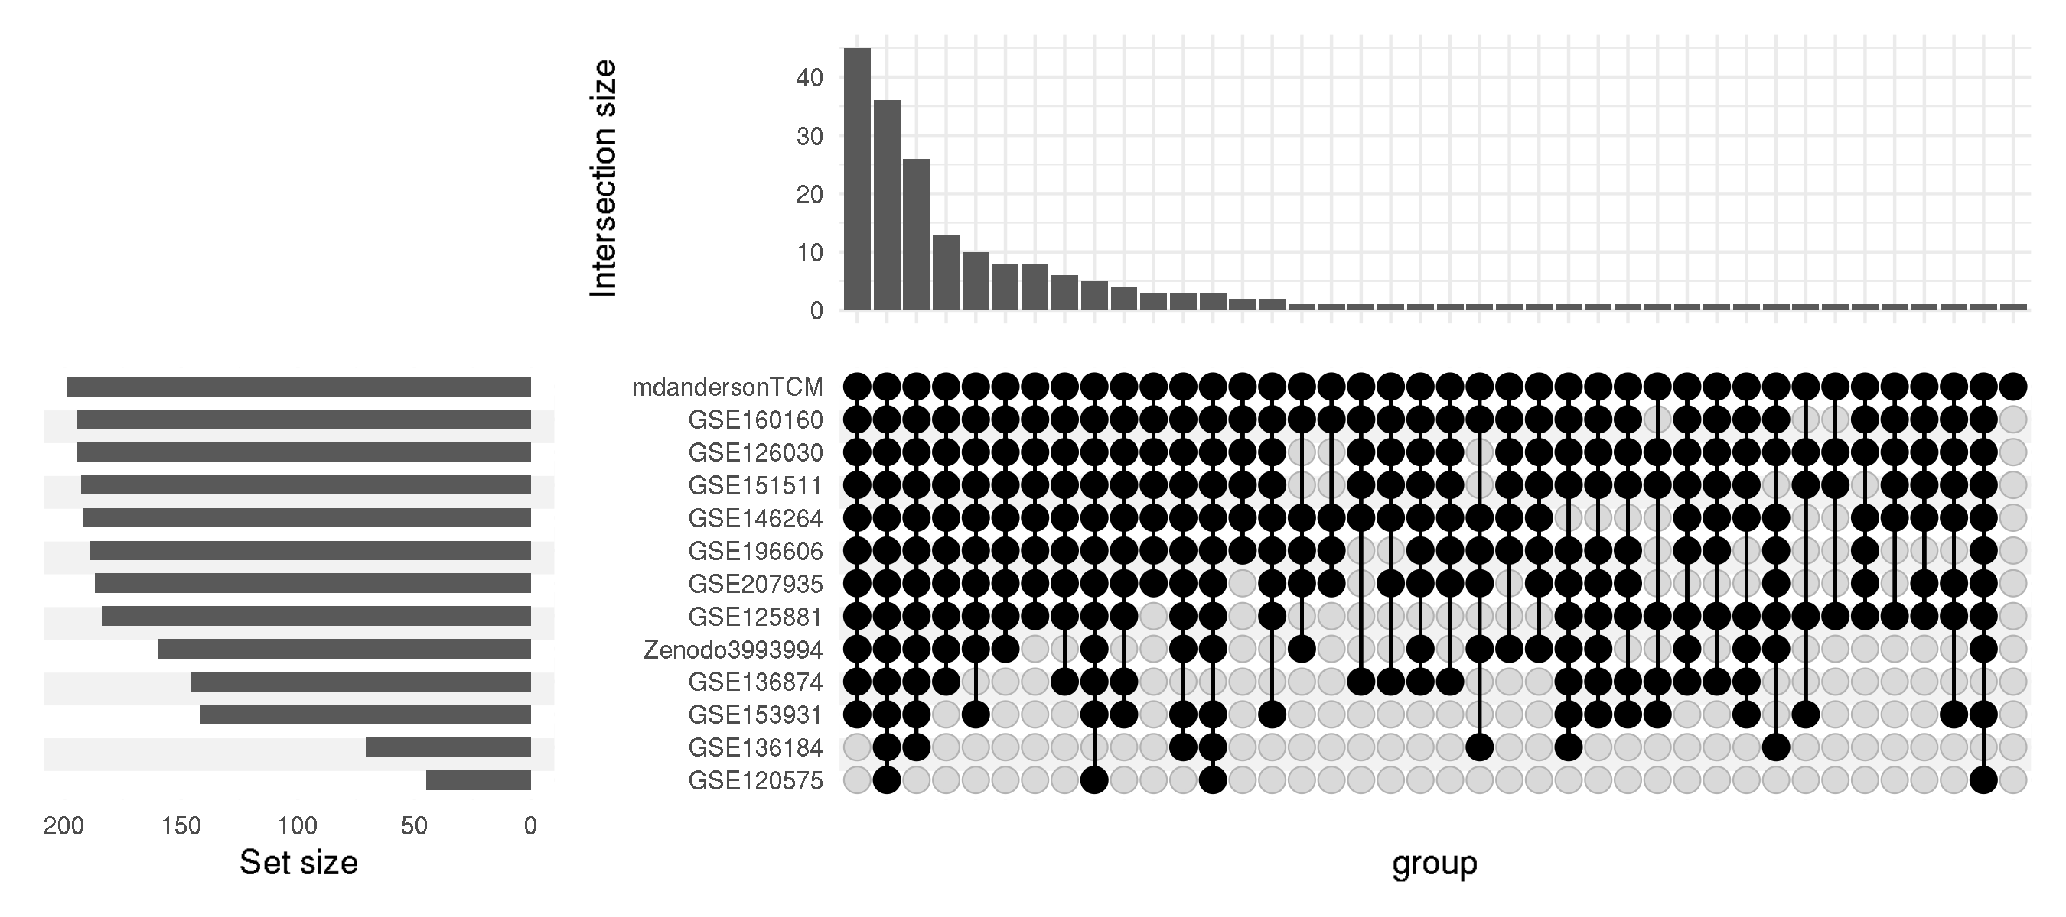
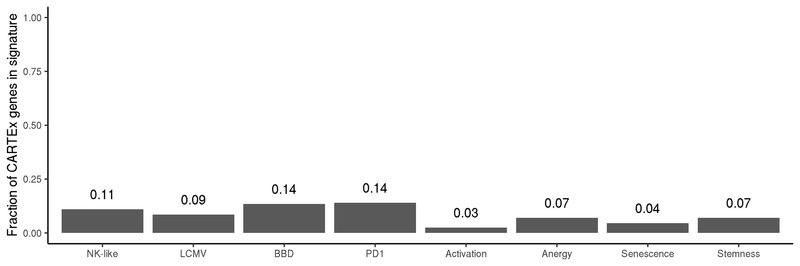
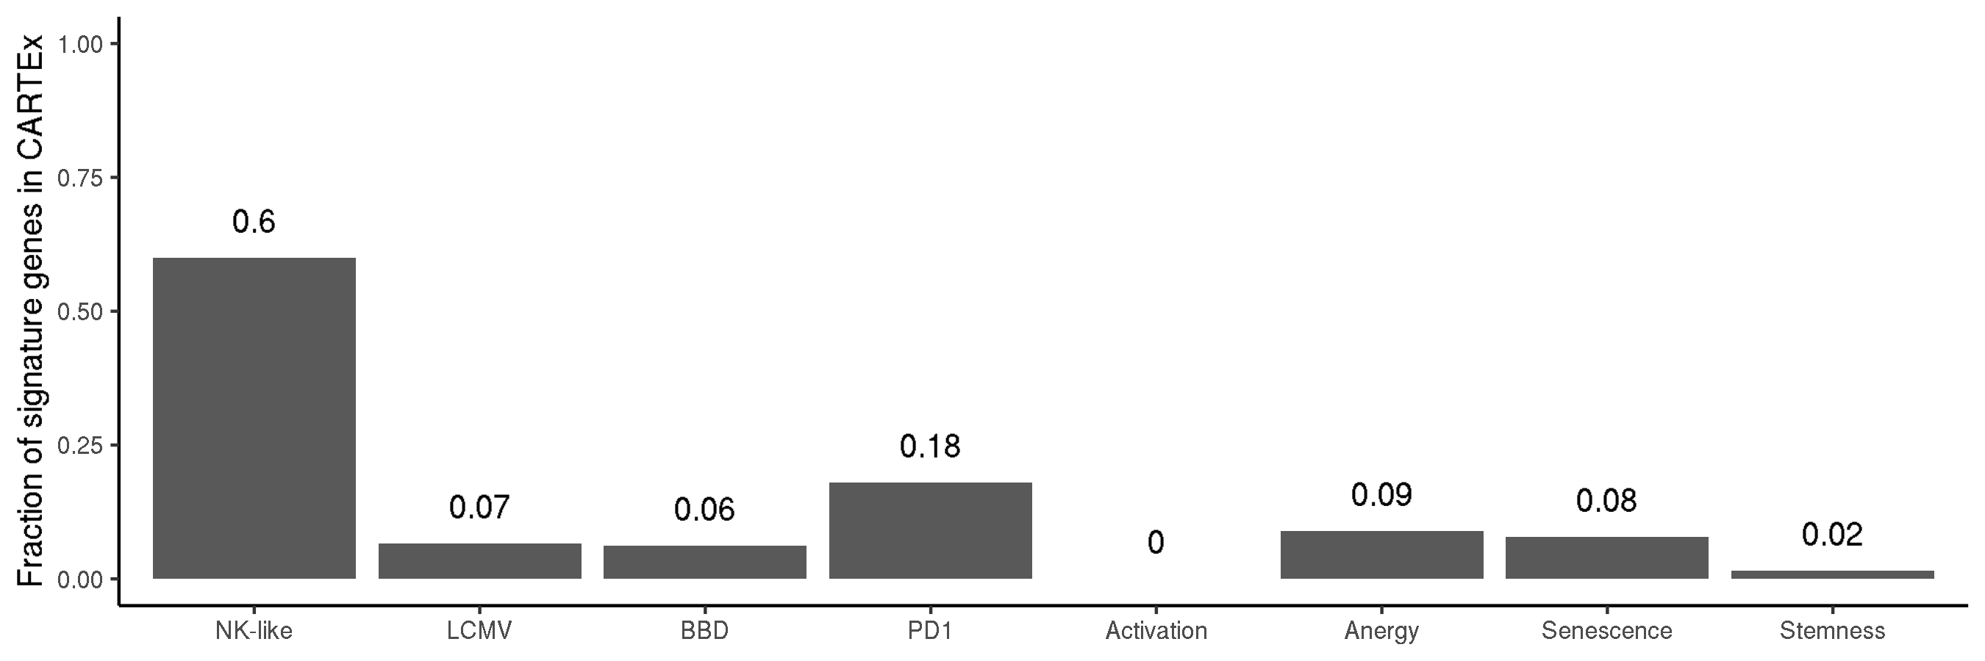
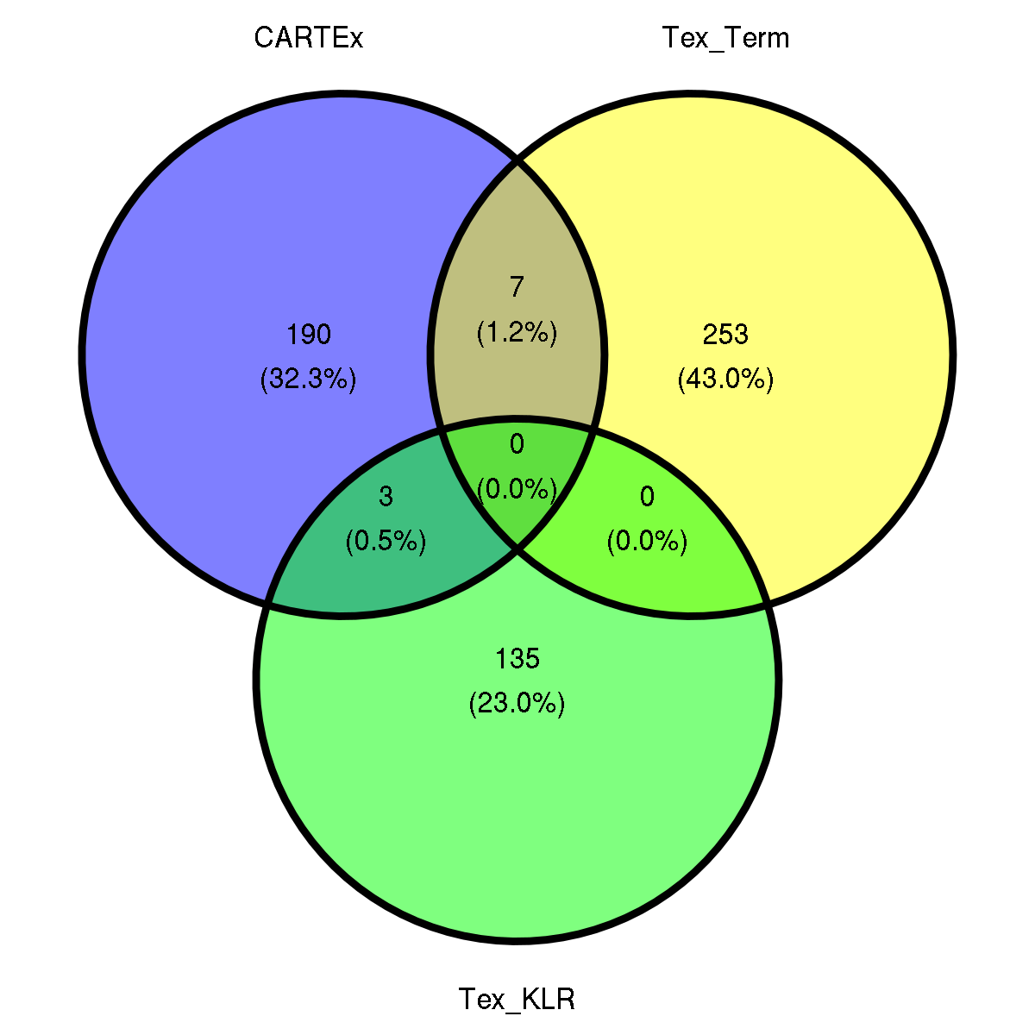
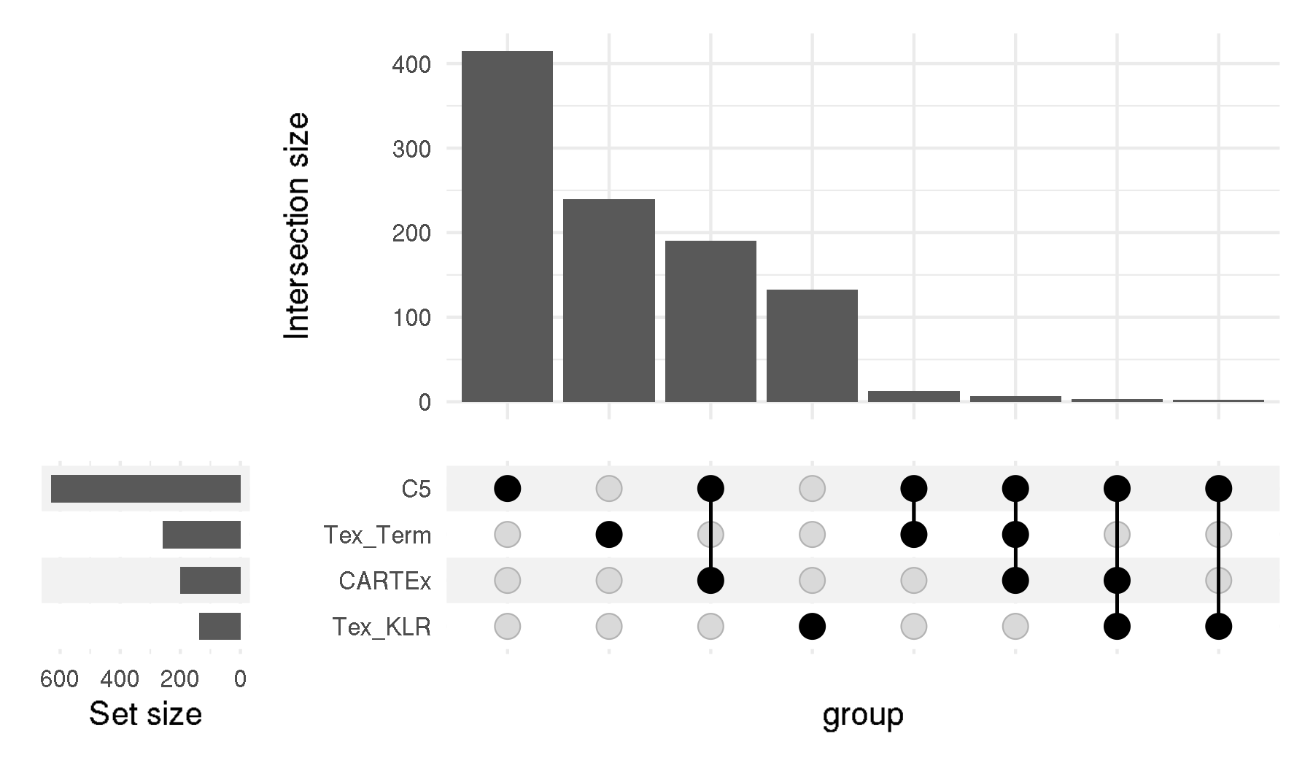
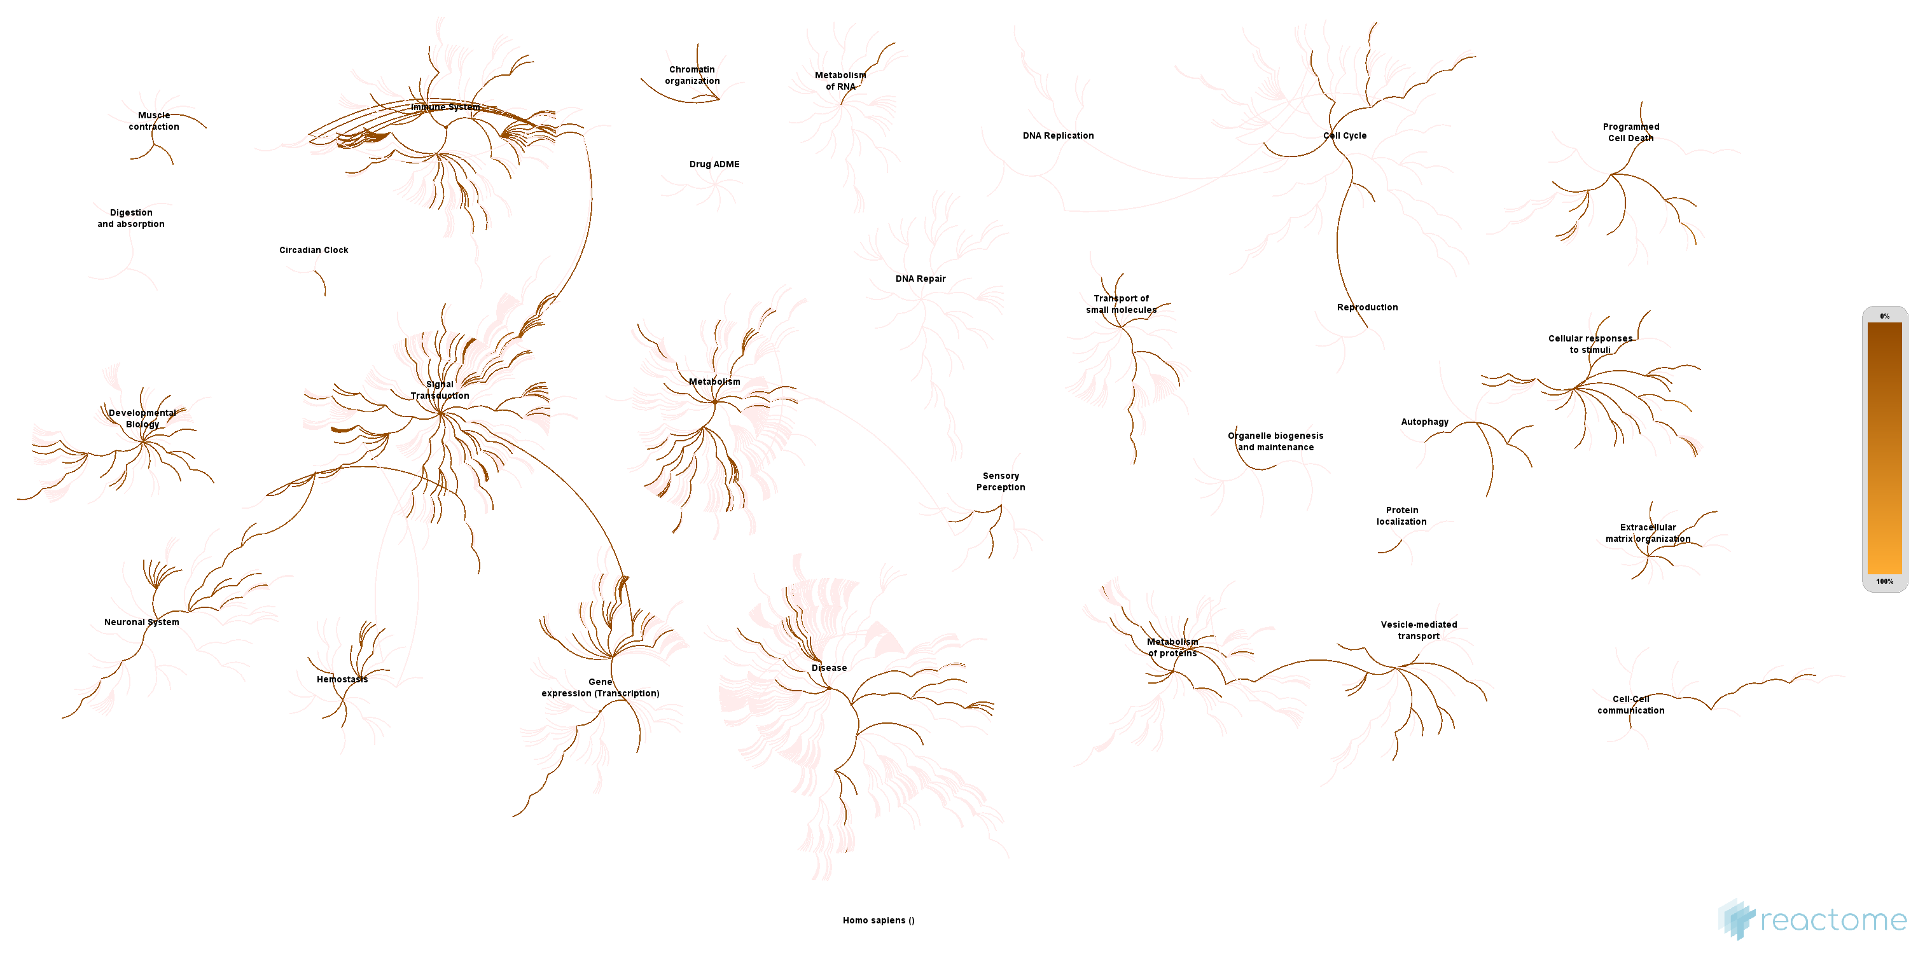
CARTEx project
Supplementary Figure 1. Signature representation
A
Jaccard index of signatures
B
Fraction of signature genes represented in experiments
C
D
E
F

Slide 6
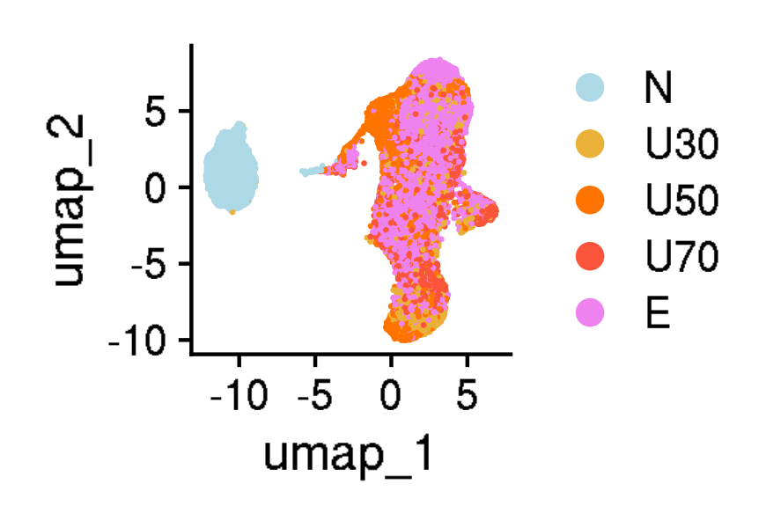
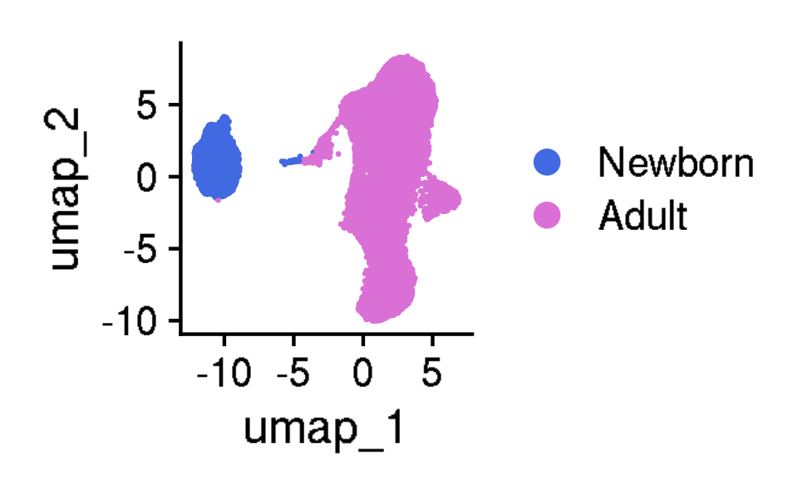
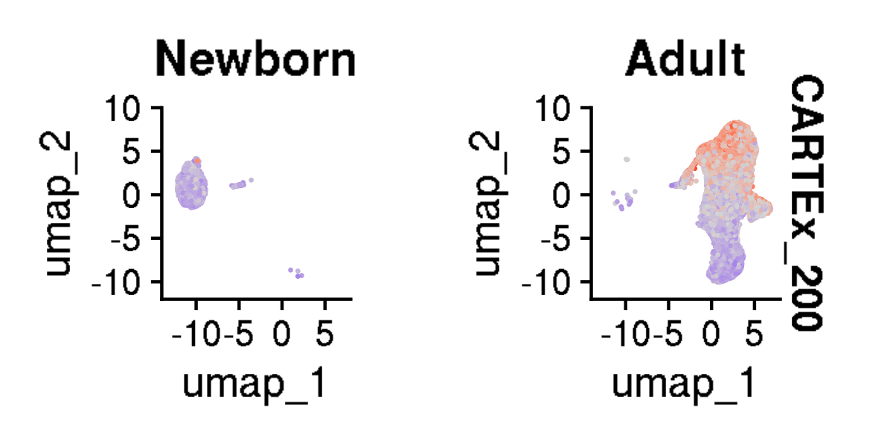
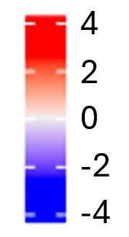
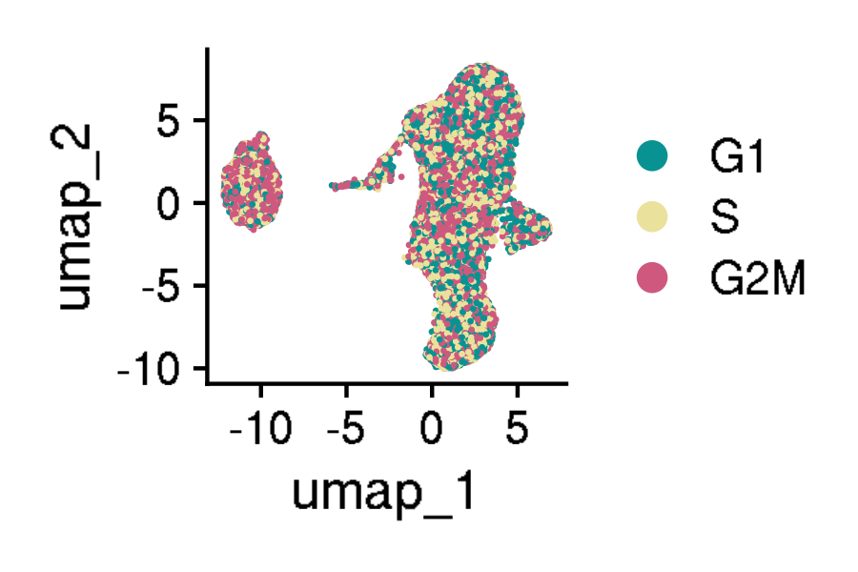
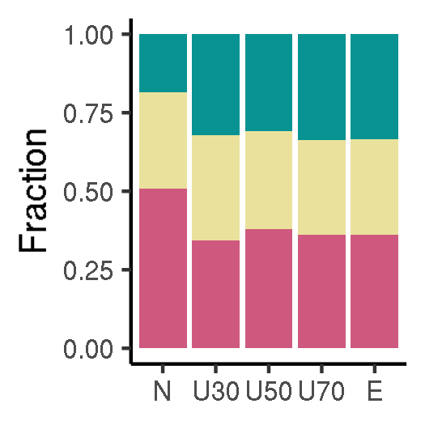
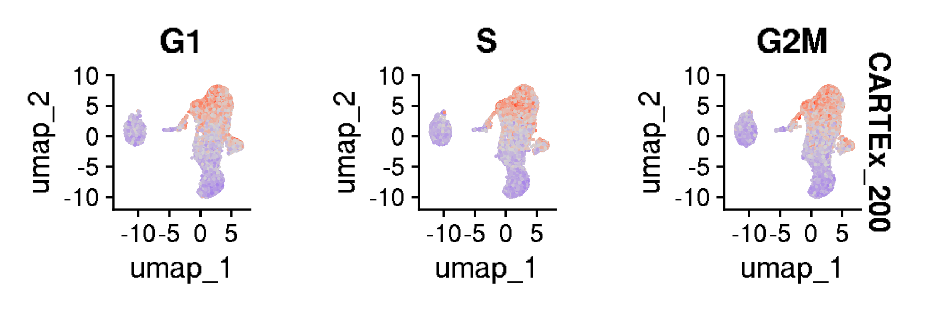
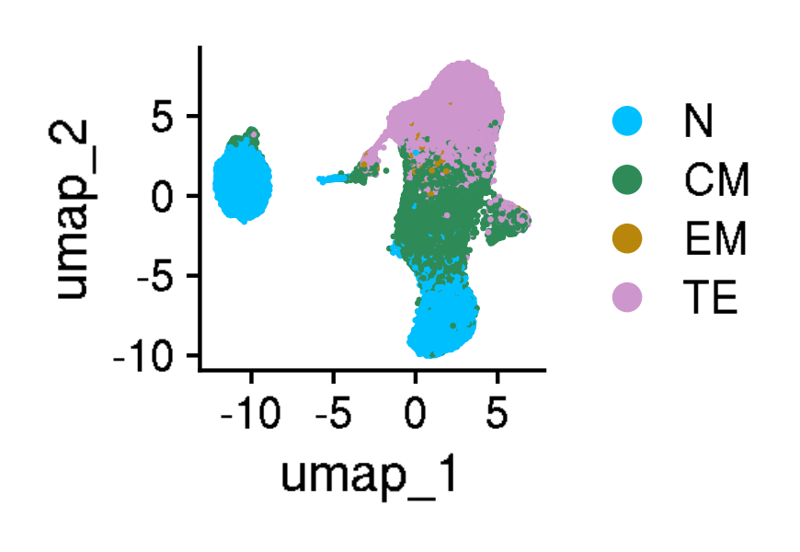
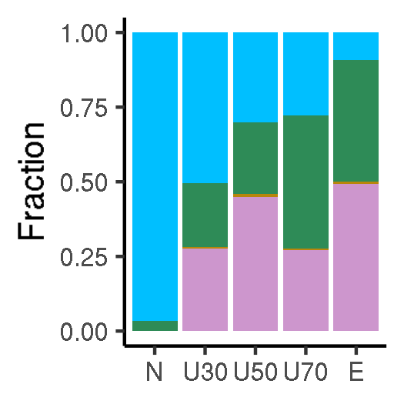
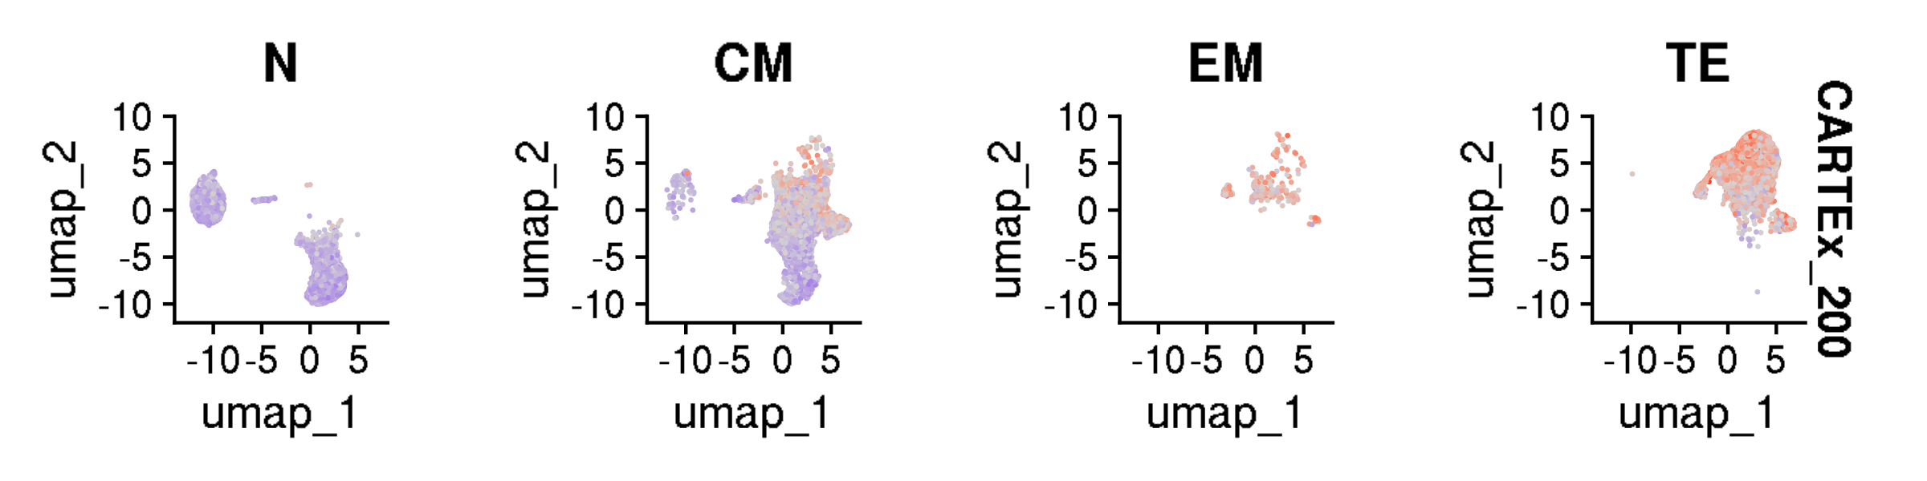
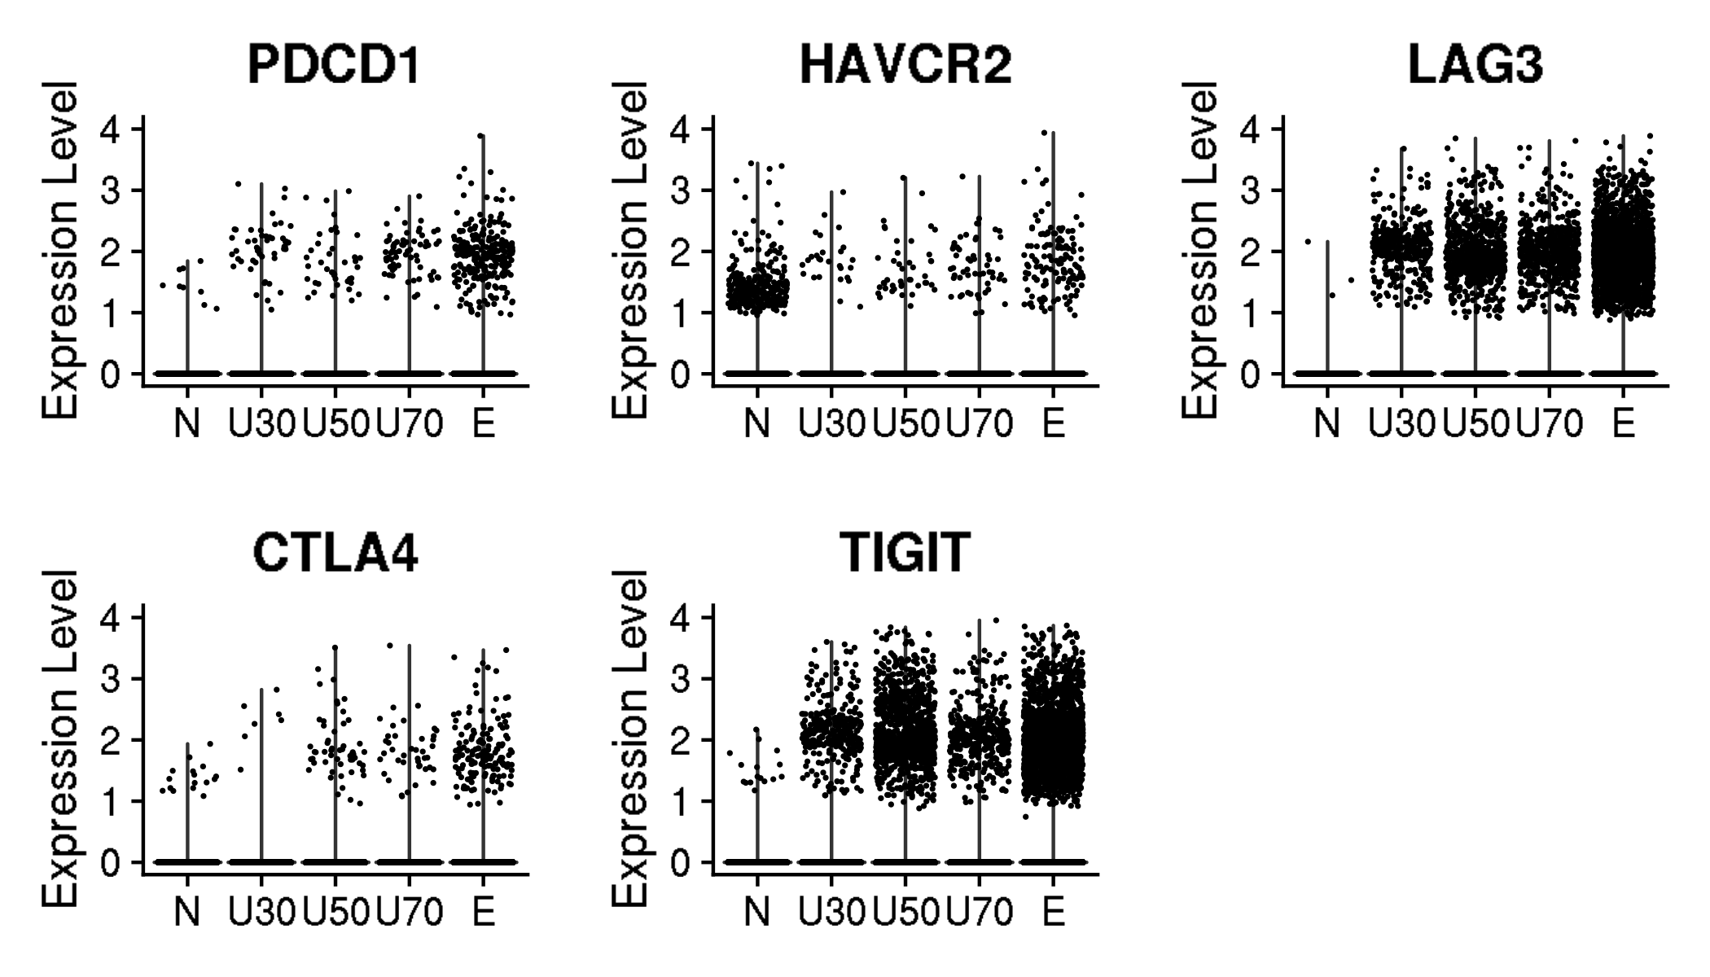
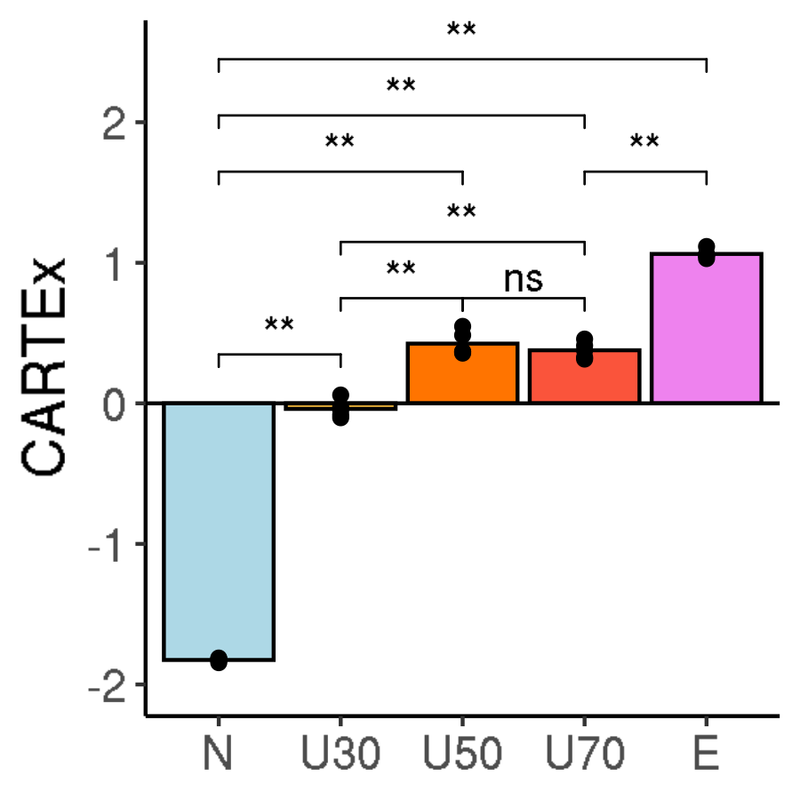
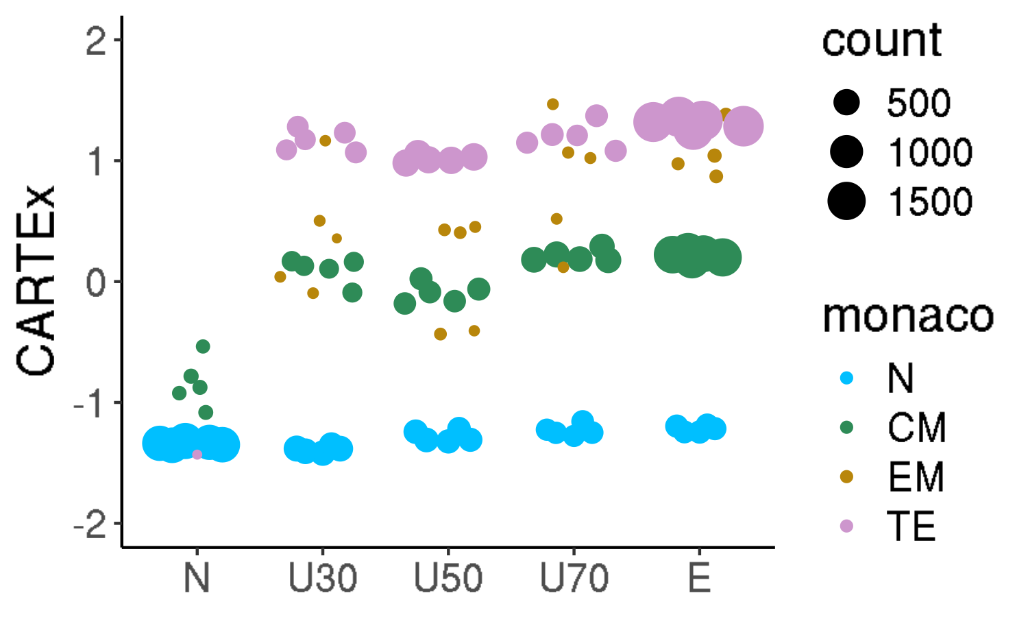
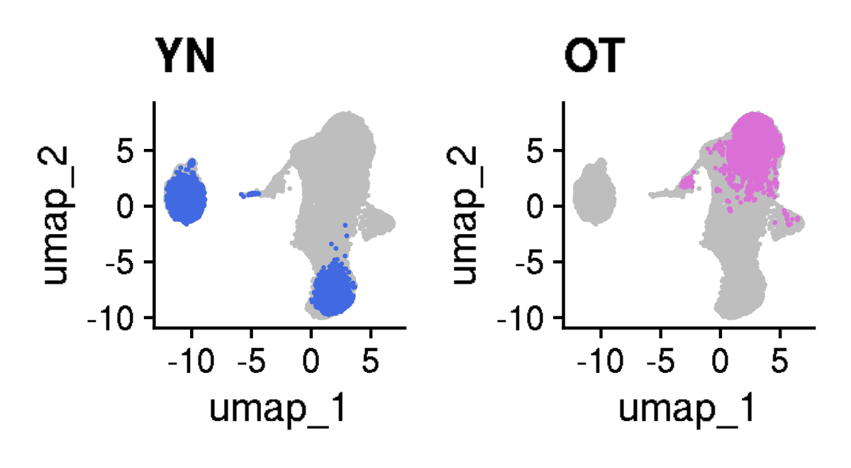
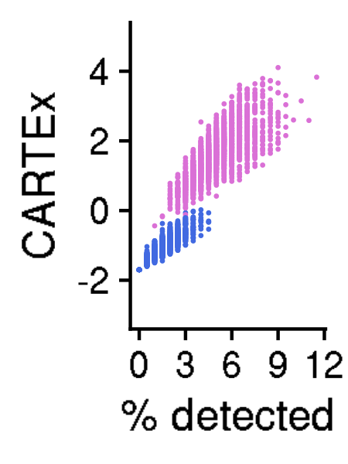
CARTEx project
Figure 4. Analysis of 39,937 CD8+ T cells from healthy donors across 9 decades of life
A
B
C
D
E
F
G
H
I
J
K

Slide 7
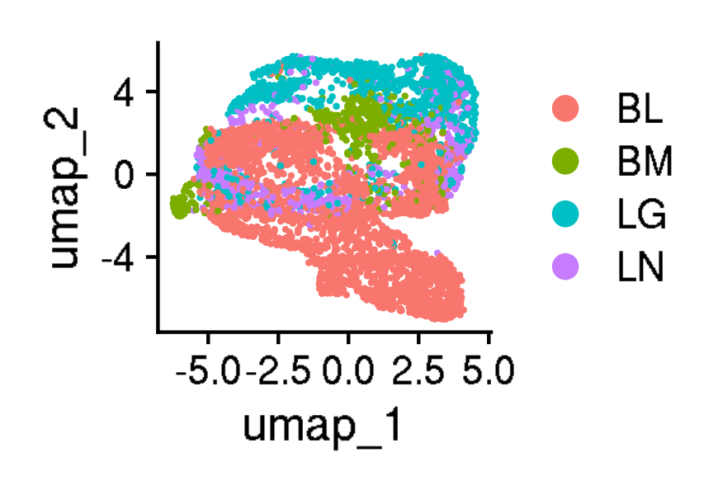
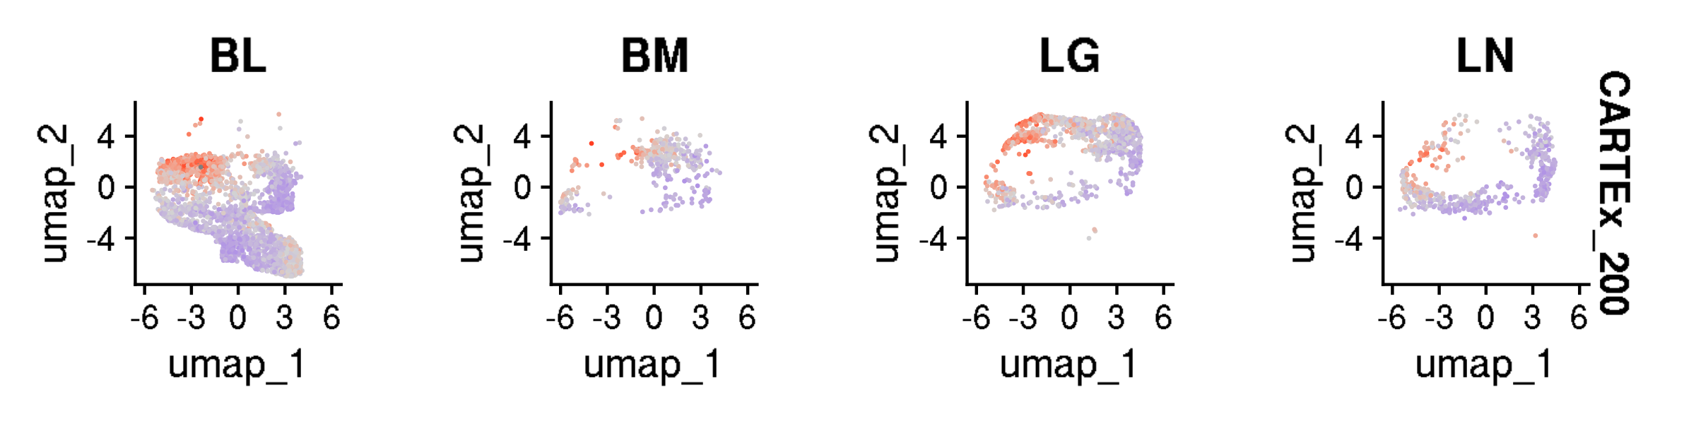
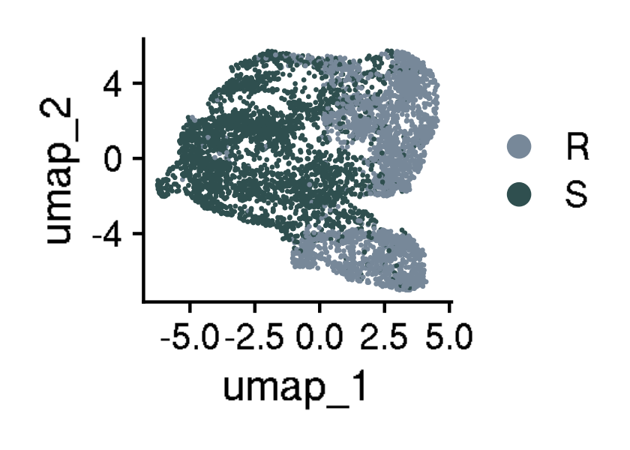
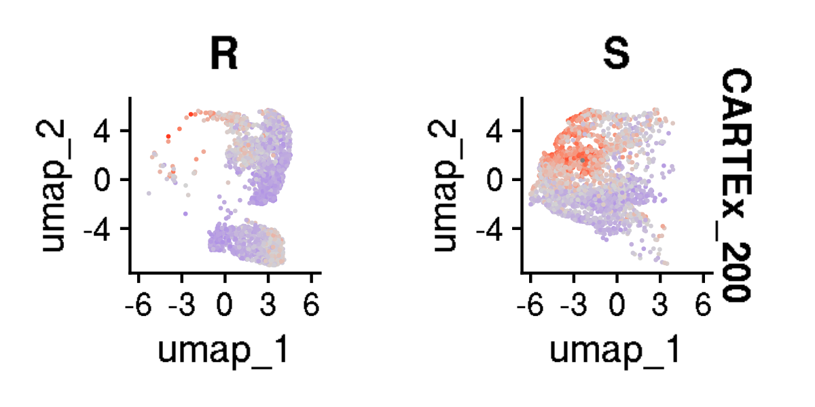
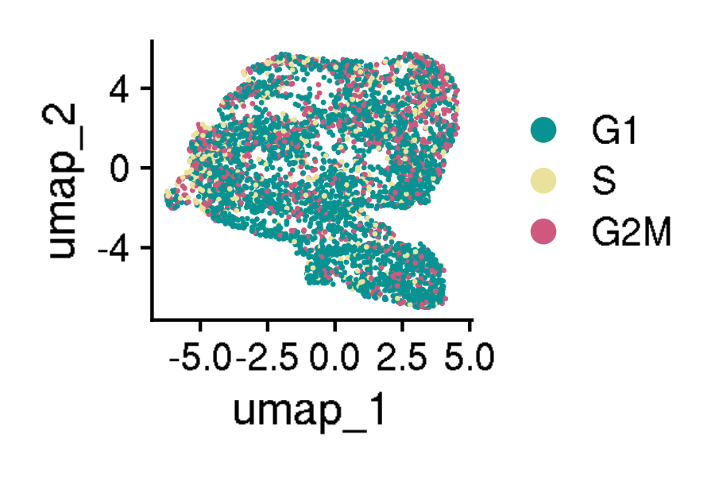
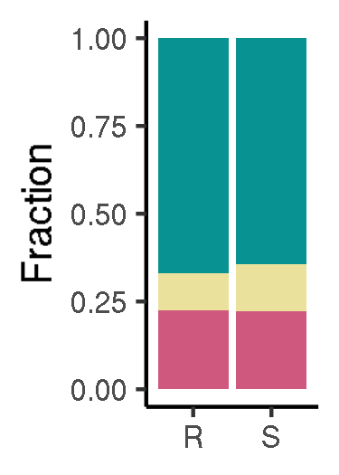
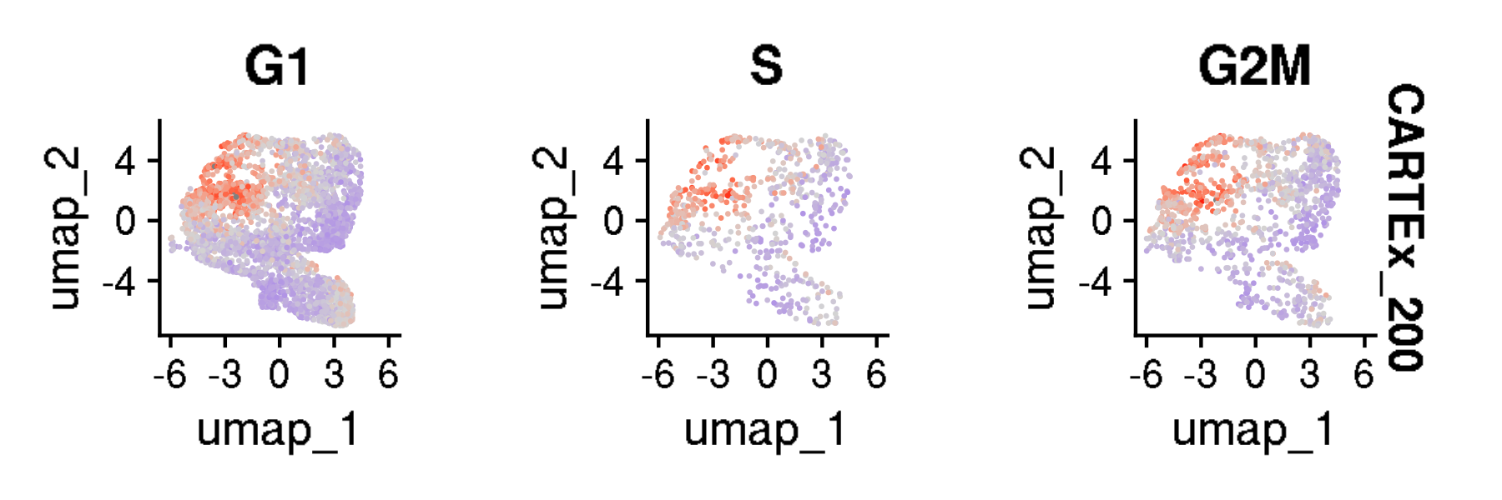
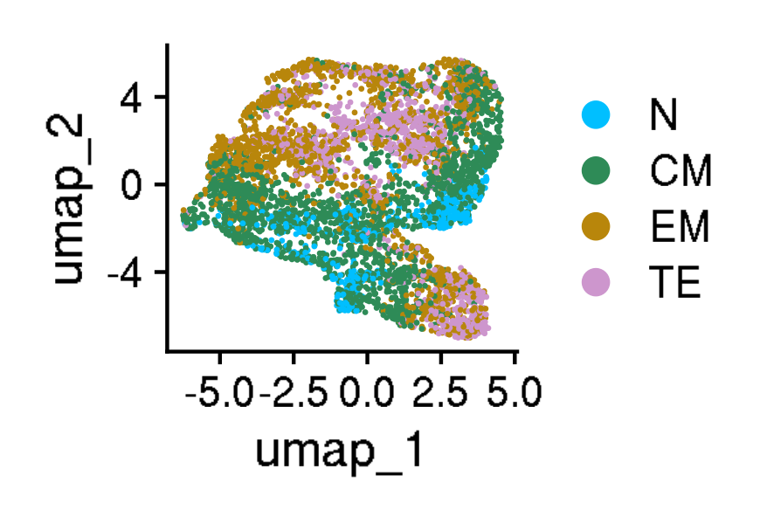
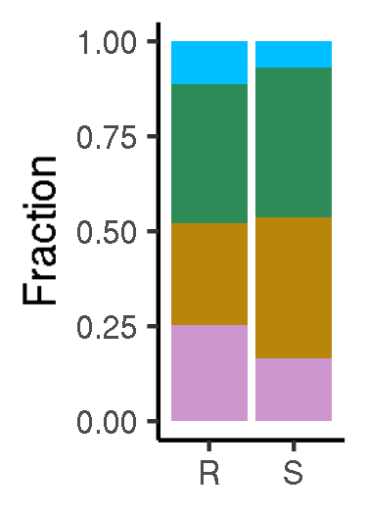





CARTEx project
Supplementary Figure 2. Analysis of 5,434 resting and stimulated CD8+ T from healthy donors
A
B
C
D
E
F
G
H
I
J
K
L

Slide 8














CARTEx project
Supplementary Figure 3. Analysis of 53,757 CD8+ T cells from 16 cancer types
A
B
C
D
E
F
G
H
I
J
K
L

Slide 9




















CARTEx project
Figure 5. Analysis of 14,436 functional and exhaustion-prone CD8+ CAR T cells
A
B
C
D
E
F
G
H
I
J
K
L
M
N

Slide 10





























CARTEx project
Figure 6. Analysis of 101,626 CD8+ endogenous and CAR T cells in clinical oncology
A
B
C
D
E
F
G
H
I
J
K
L
M
N
O
P
Q
R
S
T

Slide 11













CARTEx project
Supplementary Figure 4. Analysis of 61,583 CD8+ virus-reactive T cells including those with memory response to SARS-CoV-2
A
B
C
D
E
F
G
H
I
J
K

Slide 12












CARTEx project
Figure 7. Analysis of 25,191 CD8+ T cells from patients with STAT3 GOF syndrome
A
B
C
D
E
F
G
H

Slide 13











CARTEx project
Supplementary Figure 5. Additional analysis of STAT3 GOF CD8+ T cells
A
B
C
D

Slide 14










CARTEx project
Supplementary Figure 6. Analysis of 3,342 CD8+ T cells from patients with severe psoriasis
A
B
C
D
E
F
G
H

Slide 15











CARTEx project
Supplementary Figure 7. Analysis of 8,118 CD8+ T cells from patients with BEACH domain deficiencies
A
B
C
D
E
F
G
H
I

Slide 16
















CARTEx project
Supplementary Figure 8. Analysis of 28,105 CD8+ T cells from patients with Parkinson's disease
A
B
C
D
E
F
G
H
I
J
M
K
L
N

Slide 17
CARTEx project
EXTRA SLIDES

Slide 18






CARTEx project
Supplementary Figure 1. CARTEx signature refinement using glmnet
A
B
C
D
E

Slide 19








CARTEx project
Supplementary Figures for aging dataset (this is longitudinal data)
A
B
A

Slide 20





CARTEx project
Supplementary Figures for aging dataset (head-to-head comparison with various signatures)

Slide 21








CARTEx project
Figure 5. Analysis of 14,436 functional and exhaustion-prone CD8+ CAR T cells
A
B
C
D
E
F
G
H
I
J
K
L
M
N
O
P
Q
R
S
T
U
V

Slide 22
























CARTEx project
Supplementary Figure 4. Additional analysis of exhaustion-prone CAR T cell models
A
B

Slide 23






CARTEx project
Supplementary Figures for validation in exhaustion-prone models

Slide 24


CARTEx project
Supplementary Figures for validation in exhaustion-prone models

Slide 25





CARTEx project
Supplementary Figure for CARTEx applied to clinical oncology

Slide 26
























CARTEx project
Supplementary Figure for CARTEx applied to clinical oncology

Slide 27












CARTEx project
Supplementary Figure for CARTEx applied to clinical COVID-19

Slide 28














CARTEx project
Supplementary Figure. More STAT3 GOF (diffusion maps)

Slide 29
CARTEx project
Supplementary Figure 2. Signature representation
A
B
C
D

Slide 30

CARTEx project
Supplementary Figure 2. continued
F

